Slide 1
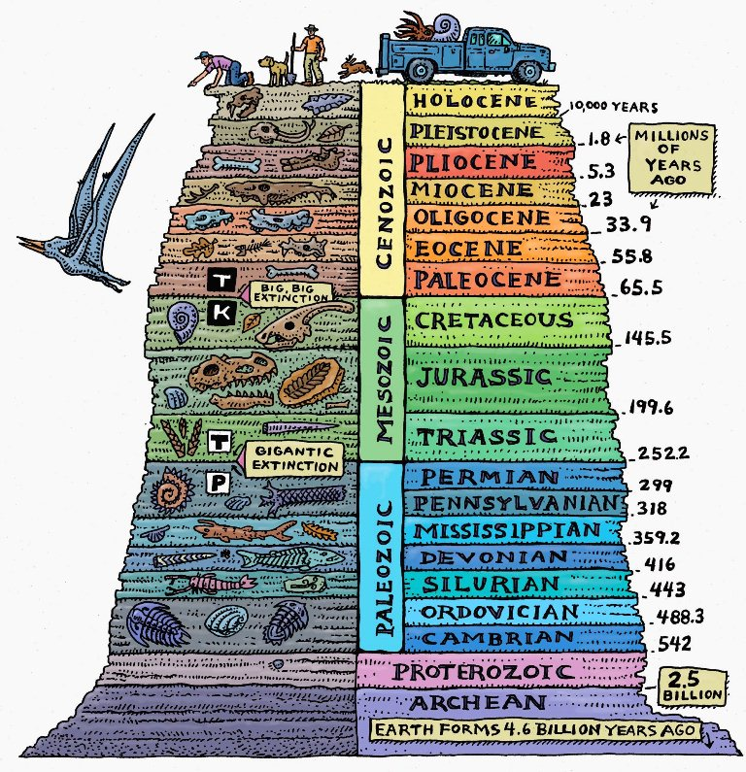
Cyclicity in the Fossil Record
Tasnuva F. Ming Khan
Analytical Paleobiology Project
July 27, 2020
Notes:
Answer a scientific question using the methods we learn in this course
Here: time series analysis, model fitting, subsampling

Slide 2
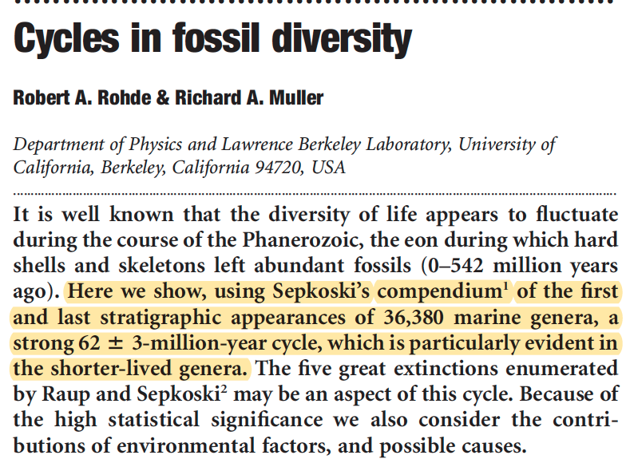
Background
Aims
Methods
Results
Conclusions
Diversity: Number of distinct genera alive at any given time
Notes:
Letters to Nature, 2005

Slide 3
Background
Aims
Methods
Results
Conclusions
Notes:
PERIODOGRAM DOES NOT IDENTIFY 62
BUT DETECTS 194 and 140

Slide 4
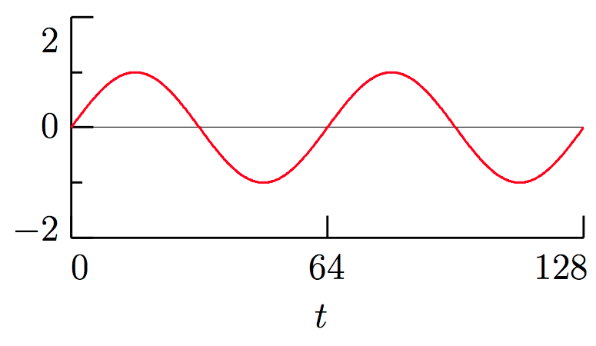
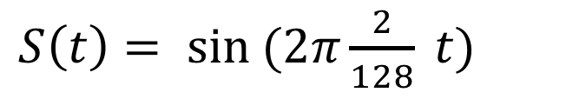
Background
Aims
Methods
Results
Conclusions
Spectral Analysis
- Decomposition of a time series into simpler trigonometric functions of sines and cosines
amplitude
wavelength
$S\left(t\right)= sin (2π\frac{2}{128} t)$
Notes:
Node to node = wavelength
0 to max value = amplitude
Can be read as “2 cycles over time span of 128”

Slide 5
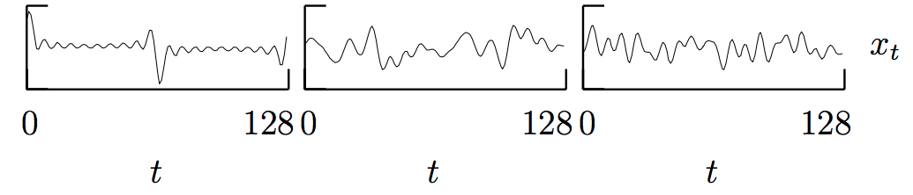
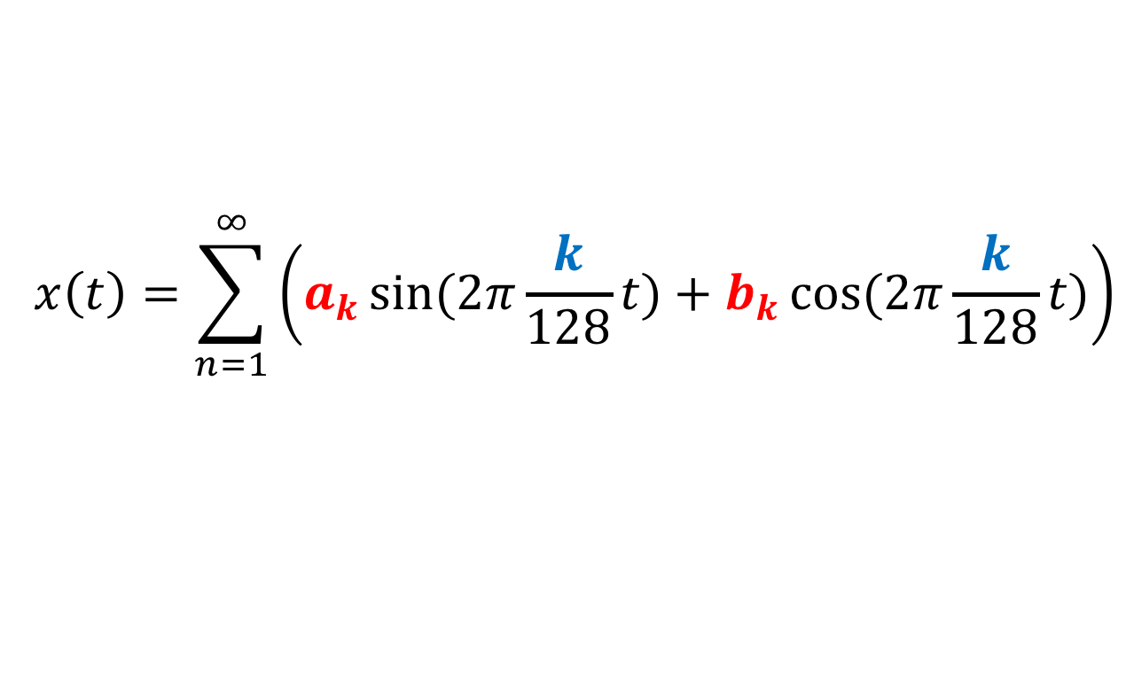
Background
Aims
Methods
Results
Conclusions
$$x\left(t\right)=\sum_{n=1}^{∞}{\left(a_{k}sin(2π{\frac{k}{128}t)}+b_{k}cos(2π{\frac{k}{128}t)}\right)}$$
Spectral analysis breaks the variance of a time series into pieces, which each have associated frequency
Power spectrum identifies the dominant frequencies
Notes:
A = amplitude
K = frequency

Slide 6
Background
Aims
Methods
Results
Conclusions
Spectral Analysis: Fast Fourier Transform (FFT)
- For Evenly Sampled Data, eg sampled every 1 million years
Spectral Analysis: Lomb Periodogram
- For Unevenly Sampled Data, eg sampled once at 1 million years, next at 4 million years, next at 10,000 years.

Slide 7
Background
Aims
Methods
Results
Conclusions
Power Spectral Density Over Phanerozoic identifies:
62 million year cycle
140 million year cycle
Notes:
R and W = estimates of spectral background
Power = measure of how strong the signal is

Slide 8
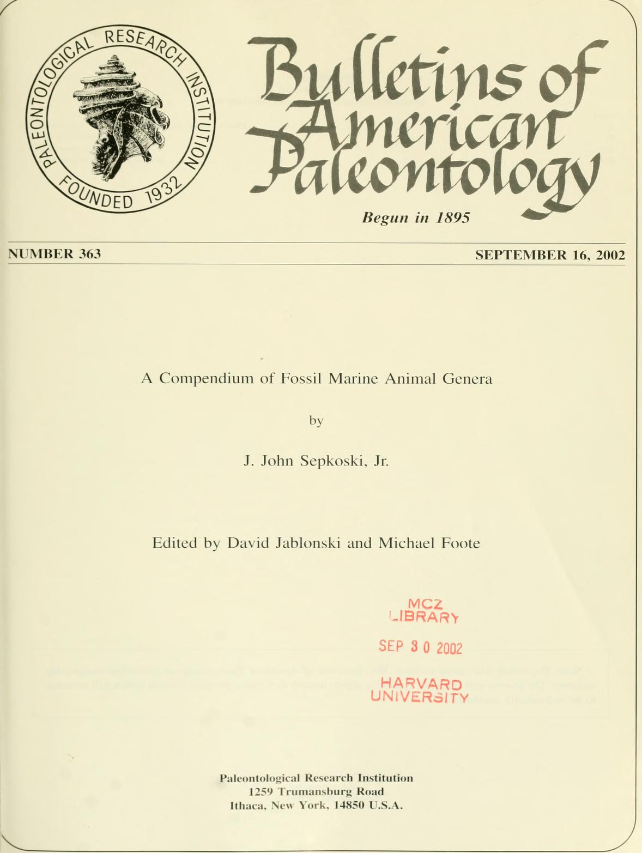

Background
Aims
Methods
Results
Conclusions
Occurrence based data from PBDB
Updated Geological Time Scale (2017)
BAP, 2002

Slide 9
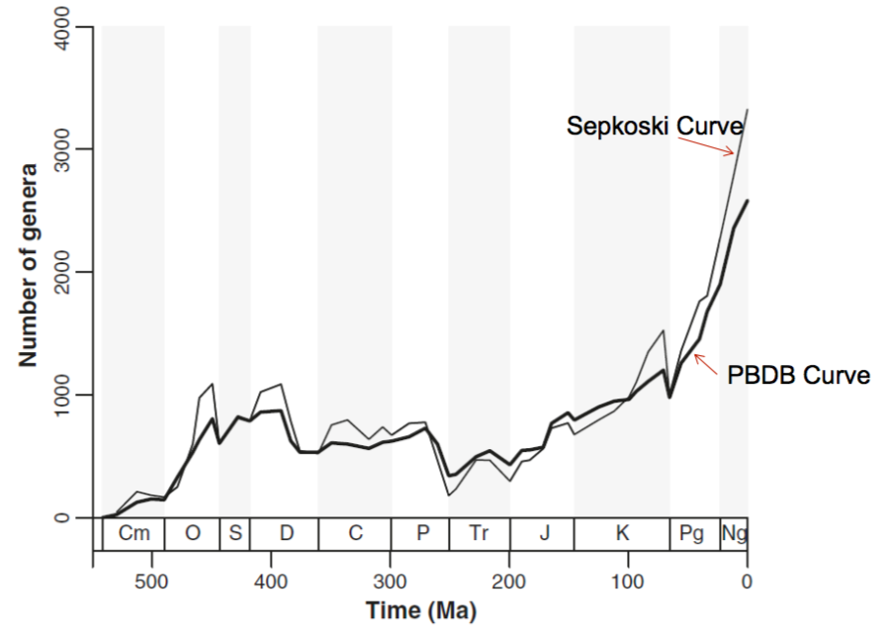
Background
Aims
Methods
Results
Conclusions
Do we see repeated patterns in originations, extinctions, and sampled in bin diversity, considering new information?

Slide 10
Guiding Questions
Background
Aims
Methods
Results
Conclusions
1) Is there a dominant cycle for extinctions, originations, and diversity?
2) How does stratigraphic binning affect the cycles?
3) What causes the cycles? (future questions)

Slide 11
Guiding Questions
Background
Aims
Methods
Results
Conclusions
1) Is there a dominant cycle for extinctions, originations, and diversity?
2) How does stratigraphic binning affect the cycles?
3) What causes the cycles? (future questions)

Slide 12
Background
Aims
Methods
Results
Conclusions
Stratigraphic Binning
Taxonomic filtering
genus level identification
marine phyla and class
homonymy
Stage Level (95)
Ten Ma Bins (49)
“chronosphere”
“divDyn”
(Kocsis et al. 2019)
Subsampling: 1500 draws
Calculate Turnover Rates
Subsampling: 4000 draws
Calculate Turnover Rates
Spectral Analysis: Lomb Periodogram for Unevenly Sampled Data
Spectral Analysis: Fast Fourier Transform (FFT) for Evenly Sampled Data

Slide 13
Background
Aims
Methods
Results
Conclusions
Spectral Analysis: Fast Fourier Transform (FFT)
- For Evenly Sampled Data, eg sampled every 1 million years
Spectral Analysis: Lomb Periodogram
- For Unevenly Sampled Data, eg sampled once at 1 million years, next at 4 million years, next at 10,000 years.

Slide 14
Subsampling, Model Fitting
Background
Aims
Methods
Results
Conclusions
Subsampling by classical rarefaction.
Turnover rates calculated using the equations of Foote (2003).
Modelled trend line is a 4th order polynomial.
Power spectrum will be applied on residuals.

Slide 15
Background
Aims
Methods
Results
Conclusions
Trend line is a 3rd order polynomial.
Notes:
THIRD ORDER POLYNOMIAL – DIVERSITY STG

Slide 16
Background
Aims
Methods
Results
Conclusions
Lomb Periodogram for Unevenly Sampled Data
Fast Fourier Transform (FFT) for Evenly Sampled Data
t = 120 million years
t = 48 million years
del = 10
t = 119.8 million years
t = 59.7 million years seq(10, 200, by = 0.1)
120 million years could be a signal?
Notes:
HOWEVER, for both, 120 is the SECOND HIGHEST PEAK

Slide 17
Comparison with Rohde and Muller (2005)
Background
Aims
Methods
Results
Conclusions
Lomb Periodogram also identifies a 60-million-year cycle, within 62+/-3
del = seq(10, 200, by = 0.1).
Fast Fourier Transform does not match (120, 48)
del = 10

Slide 18
Comparison with Omerbashich (2006)
Background
Aims
Methods
Results
Conclusions
No Lomb periodogram match (120, 60)
Fast Fourier Transform does not match (120, 48).
Detrending?

Slide 19
Background
Aims
Methods
Results
Conclusions
Fast Fourier Transform (FFT) for Evenly Sampled Data
Lomb Periodogram for Unevenly Sampled Data
t = 80 million years
t = 53 million years
del = 10
t = 133.5 million years
t = 57.4 million years
seq(10, 200, by = 0.1)
53-57 million years could be a signal?
Notes:
NEW BINNING

Slide 20
Background
Aims
Methods
Results
Conclusions
Fast Fourier Transform (FFT) for Evenly Sampled Data
Lomb Periodogram for Unevenly Sampled Data
t = 120 million years
t = 48 million years
del = 10
t = 133 million years
t = 66 million years
seq(10, 200, by = 0.1)
No signal at all?

Slide 21
Background
Aims
Methods
Results
Conclusions
Is there a dominant cycle for extinctions, originations, and diversity?
Possibly. Diversity at 60 million years, originations at 53-57 million years, none for extinctions.
2) How does stratigraphic binning affect the cycles?
Peak power spectrum value changes. Strongly dependent on sampling interval (del), bin size, data preparation.
3) Does subsampling affect the results?
Maybe but I only thought of this now.
3) What causes the cycles? (future questions)
Mathematical artefact? Or real-life phenomenon?

Slide 22
Questions?
Background
Aims
Methods
Results
Conclusions

Slide 23
Stage Level Turnover

Slide 24
Tens Diversity

